Slide 1
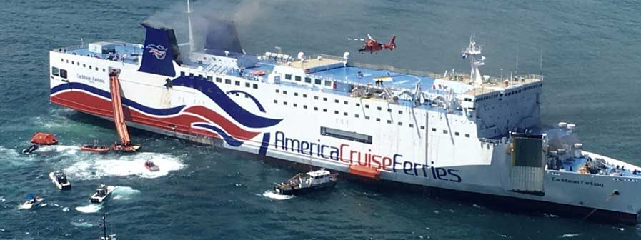
THE CARIBBEAN FANTASY
The Blue TEAM

Slide 2
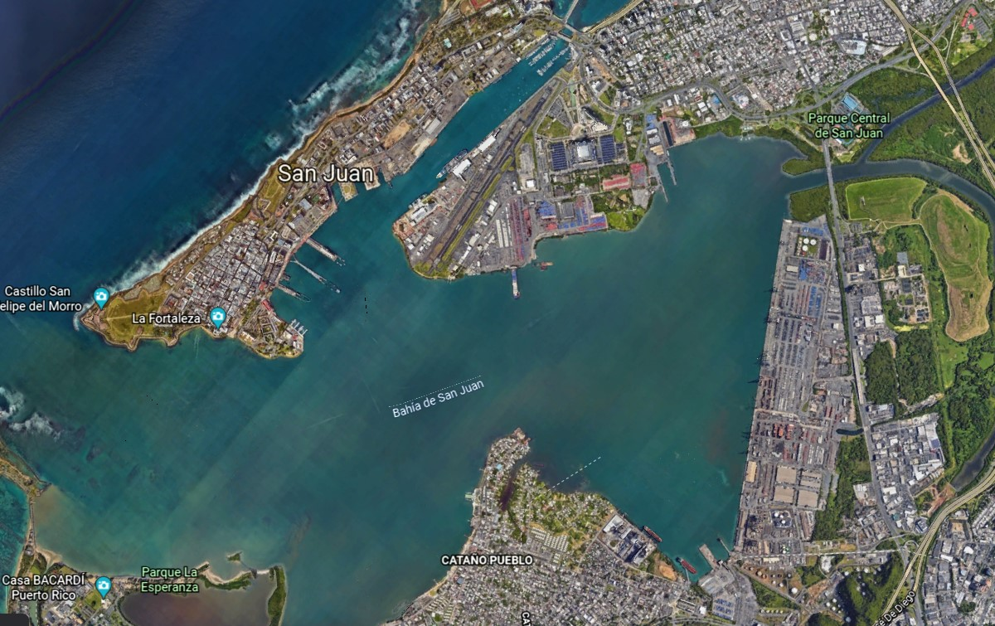
Overview The Marine Transportation System (MTS) in the Port of San Juan
Sixteen (16) piers: eight (8) are used for passenger ships and eight (8) for cargo ships
6.9 kilometers (22.7 thousand feet) of berthing including 34 docks and 46 berths. 10.2 hectares of storage and 13.9 hectares of open space.
The port's facilities, in addition to, Luis Muñoz Marín International Airport and the Cataño Ferry "Lancha de Cataño" services, are property of the Puerto Rico Ports Authority.
Immediate access to Puerto Rico's vast expressway system and several major local routes: this allows for the fast and efficient transportation of goods throughout the Metropolitan Area and the rest of the island.

Slide 3
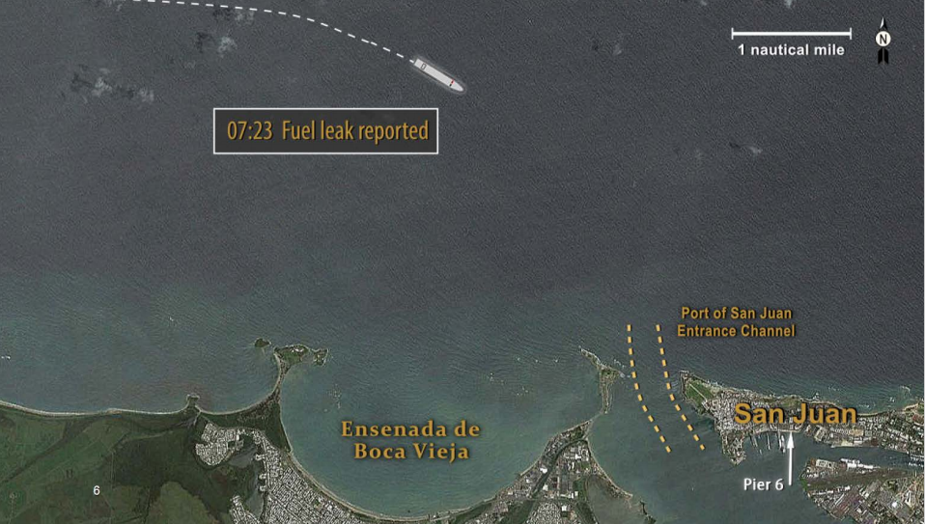
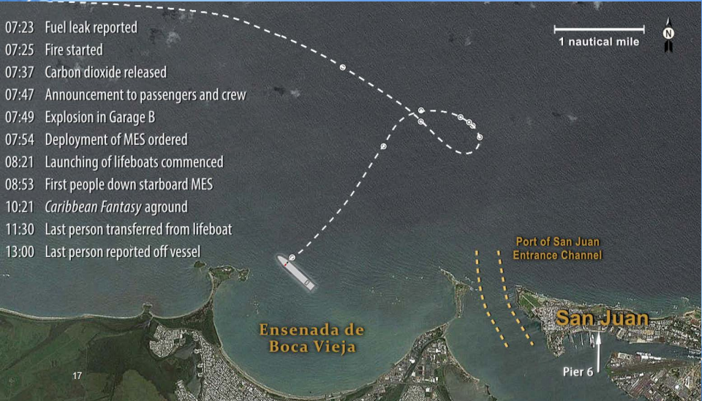
Situation
Vessel affected
Location
Passengers
Other Situations resulting from incident
Status of Port Approaches and Channel
Status of port facilities and infrastructure
Current priorities and location of the Incident/Unified Command
Resources enroute and/or requested-ordered

Slide 4
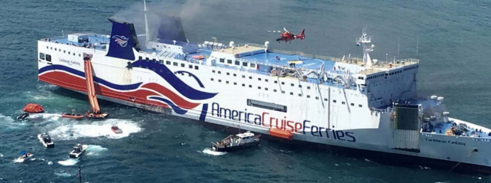
Category of MTSRP: Constrained by Response Operations
An incident with response operations whose mitigation activities may disrupt the normal MTS operations beyond pre-determined steady state thresholds –
Mass Rescue Operations
Marine Casualty that may or may not involve infrastructure damage.
Oil Discharge/Hazardous Substance Release
Notes:
The Marine Transportation System (MTS) Recovery Plan (MTSRP) for [Insert Country-specific Agency Name] supports recovery and restoration of the MTS. Responsibilities extend to incident and non-incident areas, requiring engagement with a broad spectrum of port stakeholders.

Slide 5
Caribbean Fantasy - Top Priorities for the First 24 Hours
Srl | Priorities | Considerations | Actions
1 | Safety of Responders, Safety of the Passengers, and the public: | SITREP of/on the Caribbean Fantasy: Location, number of passengers, status of the fire onboard. Status of flammable liquids in the vicinity of the vessel. Safety Cordon around the Caribbean Fantasy Determine safety zone so the public is unable to interfere with activities such as EMS, flow of emergency vehicles movements of law enforcement personnel. Identify staging area for responders. Transportation for the responders to the vessel. | Get a completed incident brief form 201 with an accurate description of the situation. Establish smart objectives along with strategies and tact with the safety of the persons on board as well as responders being the priority Ensure that all passengers and crew are safely removed from the vessel and accounted for Engage stakeholders and staff unified command structure Establish an IMT that can meet the initial challenges required for incident mitigation, including all assisting and coordinating organizations such as Police, Coast Guard and Hospitals. Inform the public, stakeholders such as the port and homeowners along the beach, as well as the media of response activities. Develop and implement an evacuation plan.
2 | Incident Stabilization: | Establish Incident Command Post. Establish Communications and Reporting Procedures. Determine Resources Needed. | Mobilize all available assets to assist in evacuation of vessel Identify central drop off point for passengers and crew to enable proper triage and accounting Manage the incident scene and mitigate against further vessel damage Engage stakeholders and staff unified command structure Commence firefighting operations to contain, extinguish, and overhaul fire. Provide life-saving assistance to all persons in distress including evacuation of survivors to a place of safety for further medical treatment. Complete survivor accountability Complete triage of injured survivors and transport to hospital.
3 | Property Preservation | Identify environmental issues to address. Install slit bars for hazardous liquids. | Vessel, Waterways, Beach etc Identify impacts to MTS infrastructure and cargo flow. Assessment for possible or imminent environmental damage Engage stakeholders and staff unified command structure
Notes:
The MTS Recovery incident management structure is a scalable and cooperative process for restoring MTS functionality within the incident area, to include resumption of trade outside of incident areas. The incident management structure must address three key operational planning factors when implementing the MTS Recovery function: a. System stabilization; b. Short-term recovery; and c. Transition from short-term recovery to long-term recovery.

Slide 6
Caribbean Fantasy “Best Response” Goals
Establishing
Establishing the MTSRU
Obtaining
Obtaining situational awareness,
Determining
Determining the impacts to the MTS and developing courses of action,
A comprehensive plan
Communicating
Communicating the status of the MTS and recovery activities –
The right people in right place at the right time
The right resources with the right tools and equipment
Demobilizing
Demobilizing the MTSRU and transition into long-term restoration.
Notes:
“Best Response” will be geared towards minimizing the adverse impacts and consequences of the incident and maximize public confidence and stakeholder satisfaction.
Critical Success Factors – The processes outlined in the MTSRP address five critical success factors for efficient and effective MTS Recovery preparedness and response activities, which include: a. Inventory and identify MTS capabilities and constraints; b. Communication of capabilities and constraints with stakeholders; c. Collaboration on mitigation plans between public and private stakeholders; d. Alignment of resources; and e. Unity of effort to mitigate constraints and maximize use or return to service of available capabilities.

Slide 7
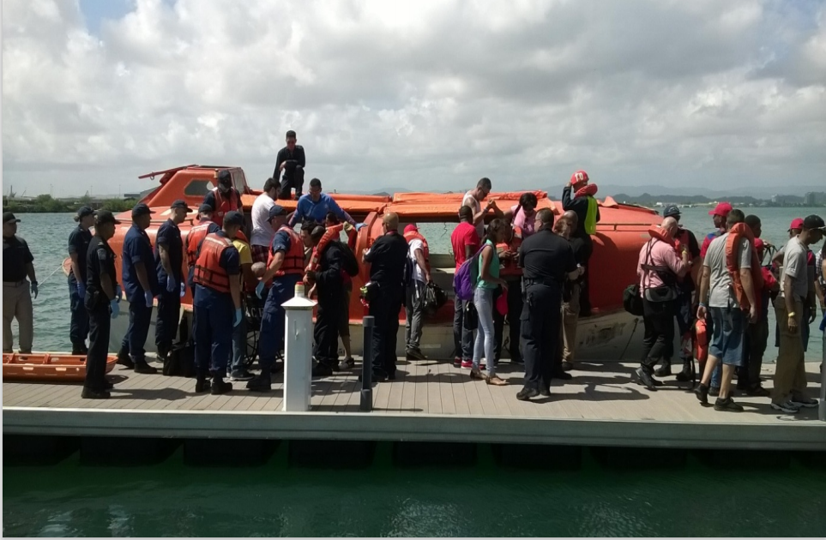
Caribbean Fantasy – ‘Best Response’ Action
Srl | Priorities | Considerations | Actions
1 | Command and Control | Establishment of a fully-staffed incident Command post. Self-preservation and by extension members of the responding team Analyse and assess the magnitude of the situation Organize responders at the Site to ensure proper accountability, security, and interagency Coordination as response | Ensure the implementation of an effective and efficient ICS organization.
 | Factors for a Successful Response
2 | Human and Animal Health & Safety | Ensure there are no public injuries or Hazardous exposures. Pets are found and taken care of. | Ensure emergency response and fire fighting has unrestricted access to vessel to ensure search and rescue can be done quickly. Mobilize resources to locate, rescue and/or evacuate, transport, and support all personnel involved in the incident.
3 | Natural Environment | Source of discharge secured Product contained Sensitive areas protected Resource damage minimized | Access incident to determine impact on natural environment and to minimize damage. Ensure source of damage is secured, sensitive areas protected, and product contained. Investigate cause of incident
Notes:
The MTS Recovery incident management structure is a scalable and cooperative process for restoring MTS functionality within the incident area, to include resumption of trade outside of incident areas. The incident management structure must address three key operational planning factors when implementing the MTS Recovery function: a. System stabilization; b. Short-term recovery; and c. Transition from short-term recovery to long-term recovery.

Slide 8
Caribbean Fantasy – ‘Best Response’ Action
Srl | Priorities | Considerations | Actions
4 | Public Communication | Positive media coverage Positive public perception Accurate and timely Information provided to the Public Stakeholder Service &Support Minimize impact Stakeholders well informed Positive meetings | Provide accurate and timely information to the media, encouraging positive public perception.
5 | Efficient ICS Organization | Mobilize and effectively use | Implement scene integrity and evidence preservation procedures.
6 | Response Resources | Delegate accordingly to areas of most critical and urgent attention Ensure that the external agencies are contacted to address the situations at hand that is wounded injured persons, environmental damage, source of the incident is contained. The teams, in coordination with Customs and Border Protection, local Fire, EMS, and other support Agencies, to synchronize medical triage and transport of the victims to the passenger reception centre or designated medical facilities as appropriate. | Commence firefighting operations to contain, extinguish, and overhaul fire. Implement measures to isolate, contain, and stabilize the incident including the establishment and adjustment of security perimeters both on land and water
7 | Ensure all members | Brought ashore are accurately processed, accounted for and medically triaged. Formulate and put into effect a progressive checklist Evidence is secured | Locate and evacuate all passengers and crew. Account for all passengers and crew.
Notes:
The MTS Recovery incident management structure is a scalable and cooperative process for restoring MTS functionality within the incident area, to include resumption of trade outside of incident areas. The incident management structure must address three key operational planning factors when implementing the MTS Recovery function: a. System stabilization; b. Short-term recovery; and c. Transition from short-term recovery to long-term recovery.

Slide 9
Reception for Families & Friends
St George Children’s Hospital
Multistorey
Parking
Incident Command
Municipal Police Station
Press
Staging Area
Landing Zone
MEDEVAC Cases
EMS Triage
TENT
Landing Site

Slide 10
What if it was an International Act – TSI?
NB. Maritime security is a continuing responsibility of IC/UC when managing an incident regardless of the initial origin of the incident.
Safety
Stabilize
Preserve
The IC/UC objectives should now be influence by the fact that there is now a cascading incident, and the likelihood that the incident can become a crime scene (including terrorism).
The IC/UC should now be thinking of implementing enhance maritime security (antiterrorist) measures to protect the MTS.
Identify vulnerable areas within the port facility and implement security measures (antiterrorist) to enhance the vulnerabilities to mitigate treat to these areas.
Implement special procedures to ensure marine safety and the safety and readiness of personnel, installations, and equipment.
Be ready to facilitate and support coordinated MTS recovery and restoration activities.

Slide 11
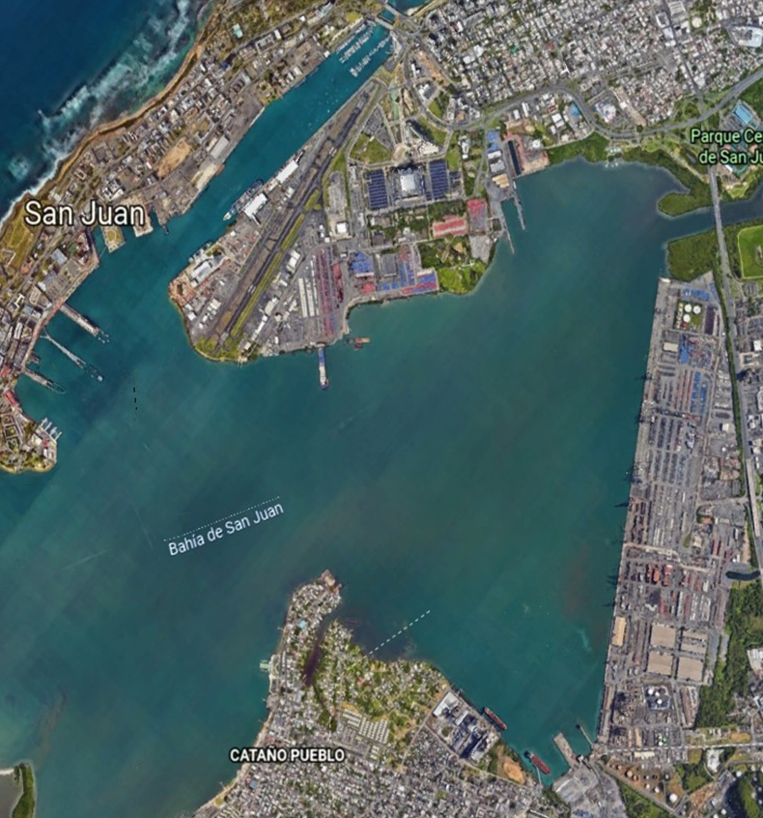
Long Term Recovery Plan
Developing a plan
Identify the effects / affects
Resources
Containment
Disposal
Cleanup
Communities, Stakeholders and Constituencies
Trying to get back to normalcy as quickly as possible
Activate MTS Recovery Plan
“Turn disaster into an opportunity”
LESSONS LEARNED
Notes:
. It starts immediately, during the response phase and can last for many, many years. There is a need to begin quickly but not finish quickly

Slide 12
Summary
Get a completed incident brief (form 201) with an accurate description of the situation.
Establish smart objectives along with strategies and tact with the safety of the persons on board as well as responders being the priority
Determine and mobilize required resources quickly. Eg:
Rescue boats & helicopters
Police
Coast guard
Firefighters
Paramedics
Hospitals
The support of any other organizations that are needed to accomplish the IC/UC objectives.
Identification of support facilities and locations such as arrival area at Port Jetty, Staging Area, IC Post, Heli-base).
Keep track of resources
Maintain situational awareness through constant communication with the IMT
Think Recovery, Resumption, Restoration

Slide 13
BLUE TEAM
LEON ADAMS
SHAWN JOSEPH
MERVYN KENNETH KNOWLES
MEKIAL JAMES
KIRK JOHNSON
KENDRA BATISTA
FRANKIE JOHN
CURTIS CALLENDER
KINGSLEY DYER
GYLBERT MUSSENDIJK
SHARONNA BROWN
LINDA NARINE
BERTRAM BOWLEG
COZIER CHARLES
ROUL WILLIAMS

