Slide 1
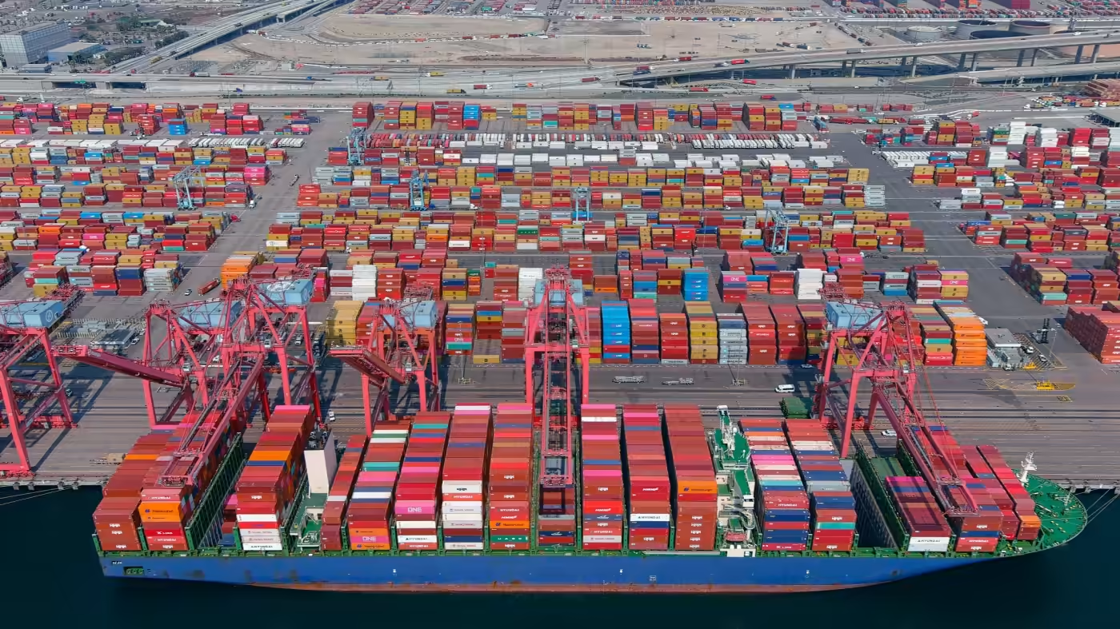
Law and (a little bit of) order
PCS and legal frameworks
16 August 2022
ANDREW BASKIN
Vice President and General Counsel

Slide 2
CONTENTS
1
Introduction
2
Data exchange among government agencies
3
Electronic transactions
4
Data privacy

Slide 3
CONTENTS
1
Introduction
2
Data exchange among government agencies
3
Electronic transactions
4
Data privacy

Slide 4
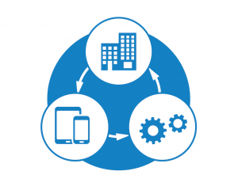
HUDSONANALYTIX
1. Planning and operations
2. Digitalization
3. Governance

Slide 5
TOPICS
1. Data exchange among government agencies
2. Electronic transactions
3. Data privacy

Slide 6
CONTENTS
1
Introduction
2
Data exchange among government agencies
3
Electronic transactions
4
Data privacy

Slide 7
DATA EXCHANGE AMONG GOVERNMENT AGENCIES
1. User experience
2. Turmoil and tumult
3. Denied!

Slide 8
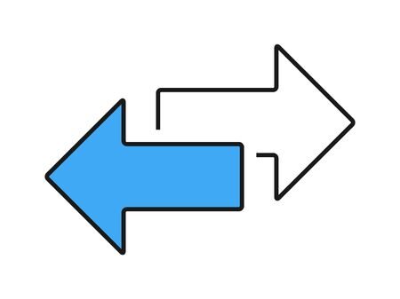
DATA EXCHANGE AMONG GOVERNMENT AGENCIES
1. Conflict: this way but not that way
2. Conflict: duplicative efforts
3. Solution: new legislation or regulations

Slide 9
DATA EXCHANGE AMONG GOVERNMENT AGENCIES
1. Confusing: ambiguous laws or regulations
2. Confusing: silent laws and regulations
3. (Potential) solution: MoUs or SLAs

Slide 10
CONTENTS
1
Introduction
2
Data exchange among government agencies
3
Electronic transactions
4
Data privacy

Slide 11
ELECTRONIC TRANSACTIONS
1. User experience
2. Paper documents
3. Handwritten signatures

Slide 12
ELECTRONIC TRANSACTIONS
1. Legal validity
2. Signatures
3. Requirement?

Slide 13
CONTENTS
1
Introduction
2
Data exchange among government agencies
3
Electronic transactions
4
Data privacy

Slide 14
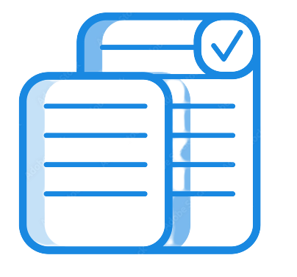
DATA PRIVACY
1. Data security
2. Data privacy
3. Data privacy laws

Slide 15
DATA PRIVACY
1. Data protection assessment
2. Data privacy officer
3. Consent

Slide 16
COMFORTING CONCLUSION
Data e
xchange among government agencies
2. Electronic transactions
3. Data privacy

Slide 17
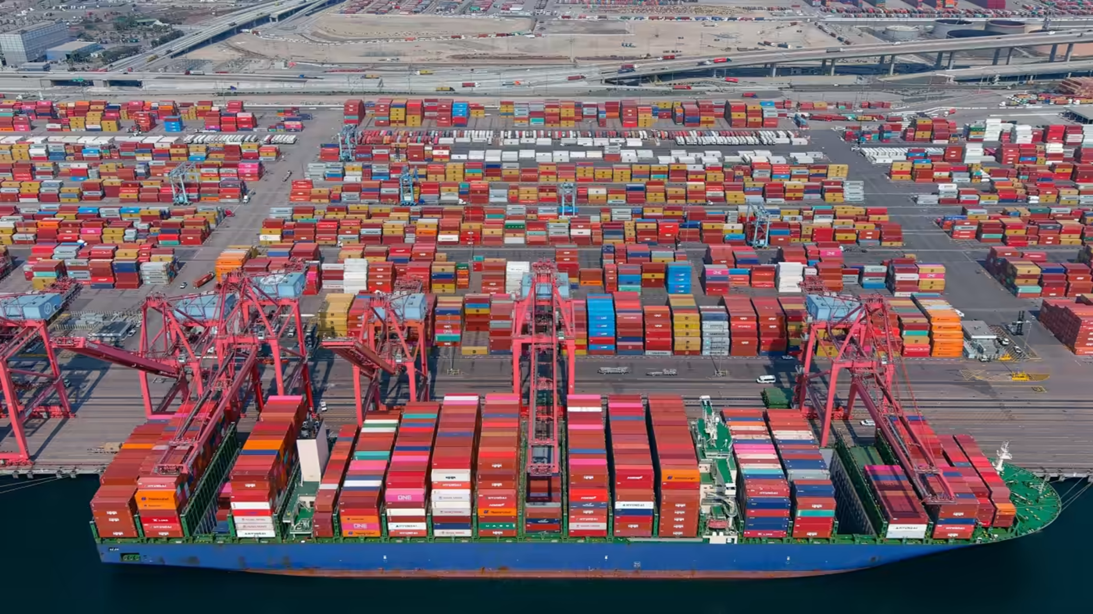
QUESTIONS AND COMMENTS

