Slide 1
Legal Framework: Mitigation of Cyber Risk in Ports, Terminals, and the Maritime Industry
September 23, 2022
Andrew R. Lee, CIPP/US
Partner, Jones Walker LLP, New Orleans

Slide 2
Please note:
The information described in this program is general in nature, and may not apply to your specific situation. Legal advice should be sought before taking action based on the information discussed. No attorney-client relationship is formed merely by your attendance at this event.

Slide 3
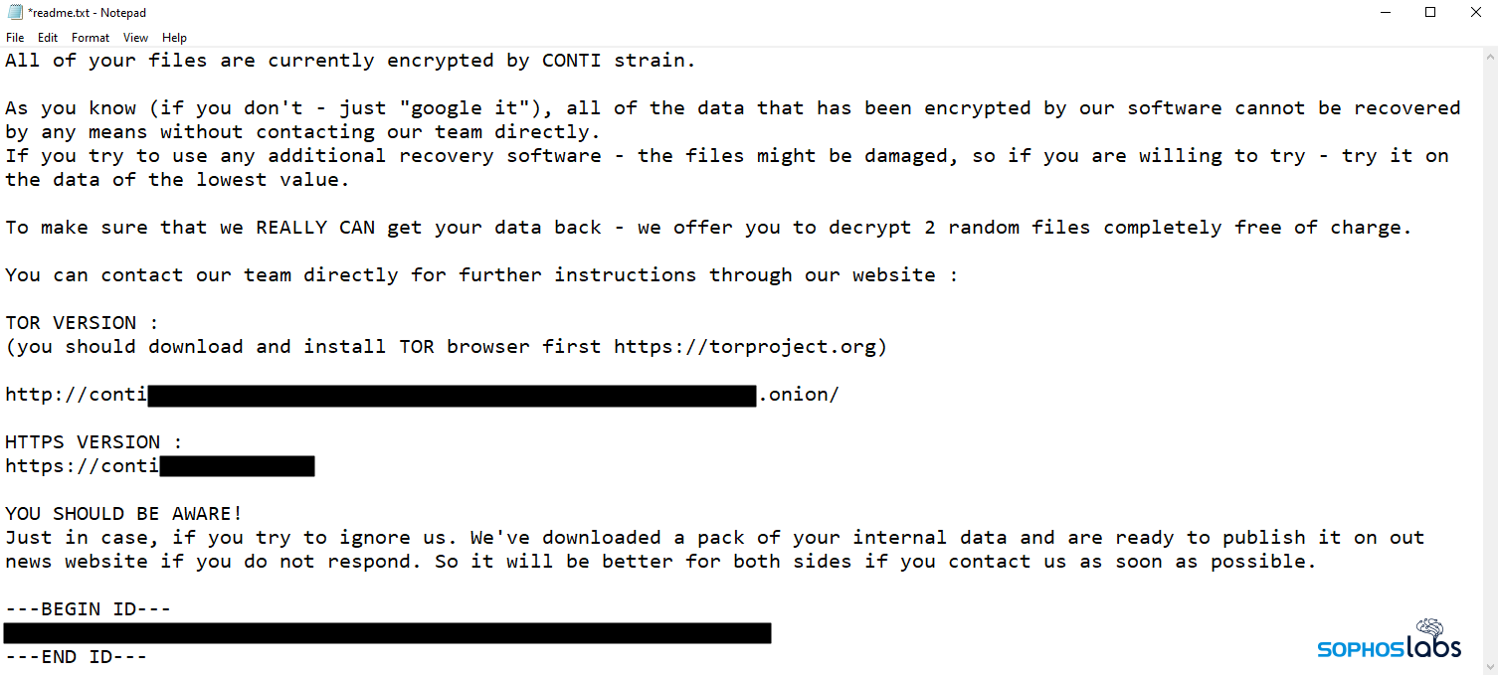
A bad start to your day.

Slide 4
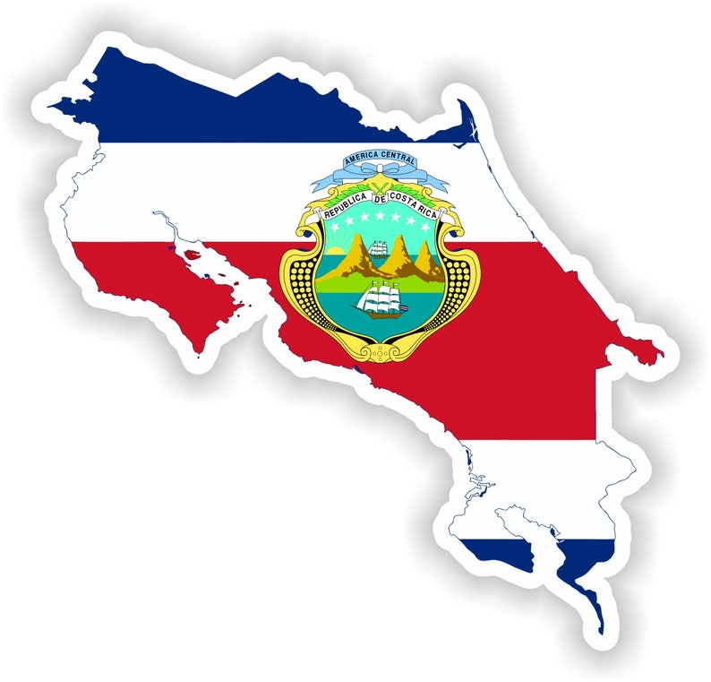

Slide 5
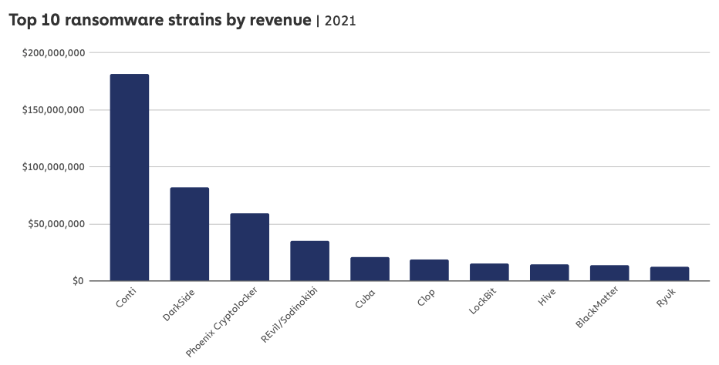
Conti yielded $180M Revenue 2021

Slide 6
Annual cost of Ransomware
2015: $325 million (USD) annually
2017: $5 billion
2018: $8 billion
2019: $11.5 billion
2021: $20 billion
Source: Cybersecurity Ventures, June 2022

Slide 7
What will it cost me? (IHS Markit / Fairplay Survey int’l survey)
17% -- $100,000 and up
6% -- $500,000 and up
3% -- over $1 million

Slide 8
Container shipper breach: Maersk NotPetya Incident
June 2017
$250-$300 mm impact
Affected container shipping, tug boat and oil tanker operations
Caused global shutdowns
Company had “only average” cyber-readiness
Jim Hagemann Snabe
Maersk Chairman
Notes:
On Tuesday, June 27, Maersk was hit by the “NotPetya” computer virus that shut down its container business. Soon mainstream and industry media outlets were reporting stoppages at Maersk operations in Rotterdam, Los Angeles, Mumbai, Auckland and a dozen other ports around the globe. Fear of the unknown – and prospects that the virus could spread – caused worldwide consternation throughout the maritime industry.
Part of the problem is that “Many port IT shops are resourced to the cyber threats of yesterday,” says Port Fourchon’s Danos. “While installing security patches has always been an essential part of IT operations, now the threat and patch notifications are becoming more frequent, more complex and thus more time-consuming to implement. The staffing levels cannot keep up with the continuous security workload, which can create momentary windows of vulnerability that can be exploited.”
Shortly after the attack, Maersk chairman Jim Hagemann Snabe admitted to a panel at the World Economic Forum that Maersk “were only average when it comes to cybersecurity”. “For the time being, we are speaking about simple attacks,” Snabe said. “The bad guys are very economically savvy. So fundamentally, if there is a real opportunity for them, they will use technology to hold attacks.”
The effect on Maersk was substantial but not debilitating. In its second quarter report, the company noted that “Business volumes were negatively affected for a couple of weeks in July and, as a consequence, our third quarter results will be impacted. We expect the cyberattack will impact results negatively by $200-300 million.”

Slide 9
The future of the maritime industry

Slide 10
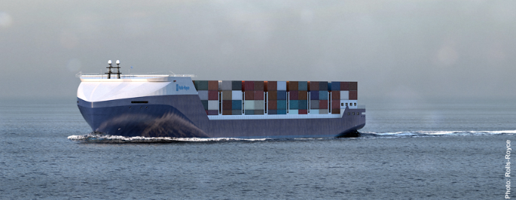
Autonomous vessel (MASS)

Slide 11
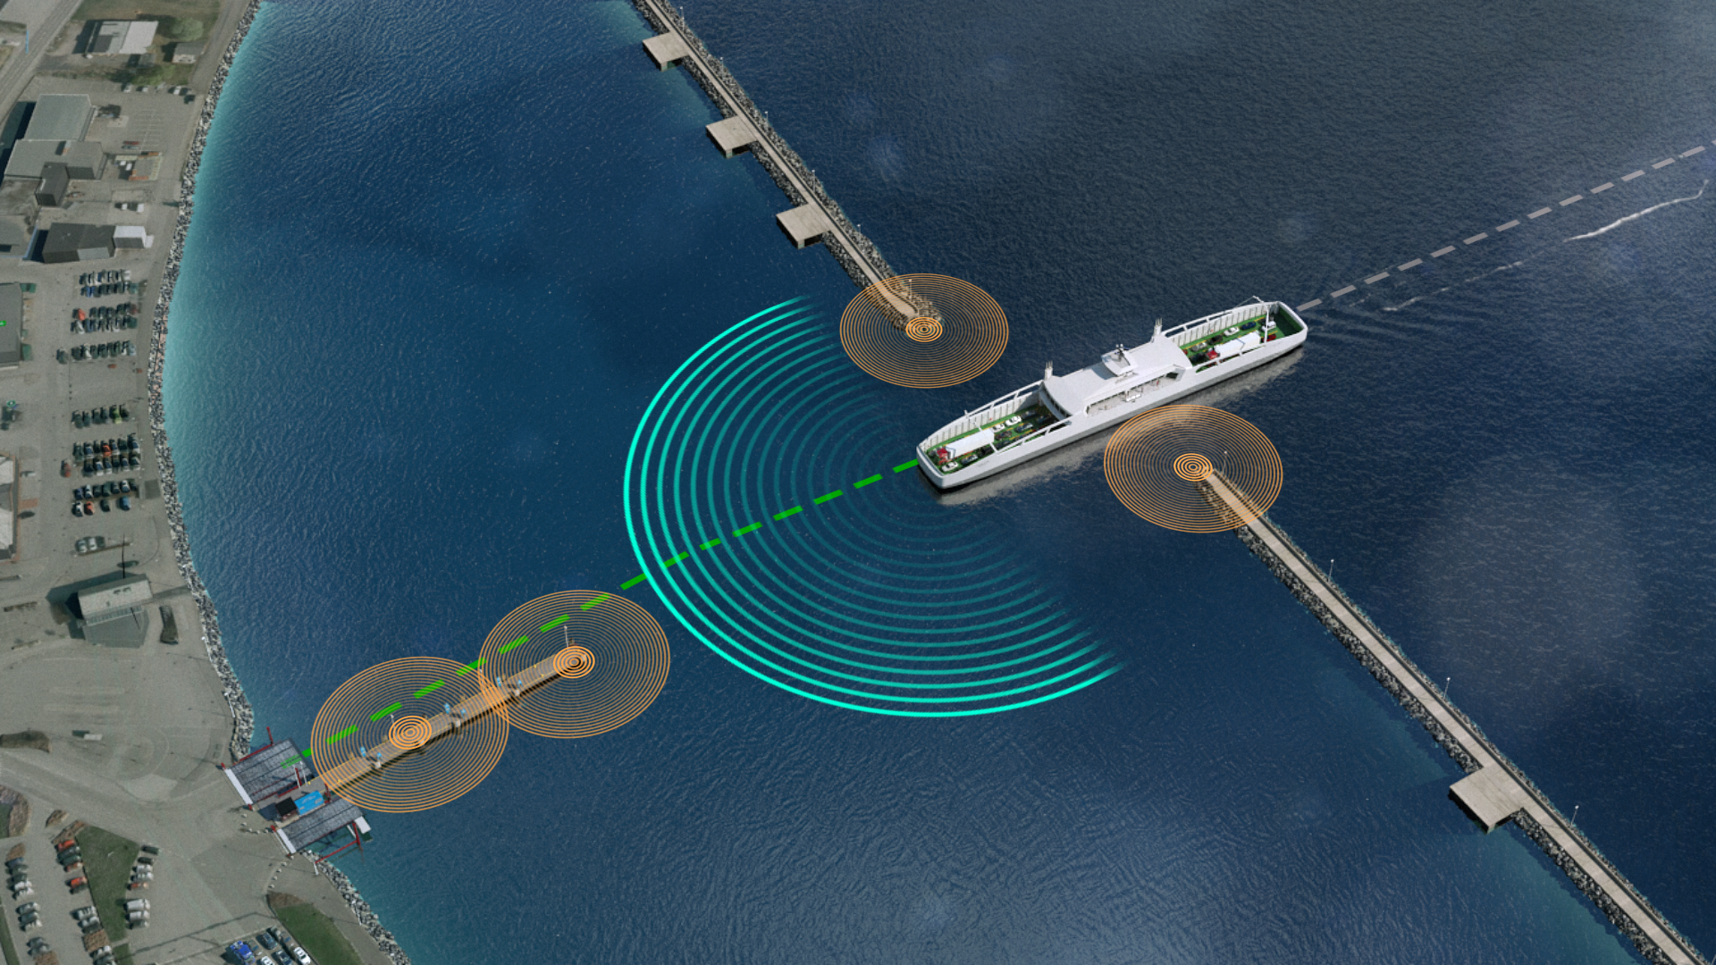
MASS Vessel

Slide 12
The self-driving automobile

Slide 13
The Falco

Slide 14
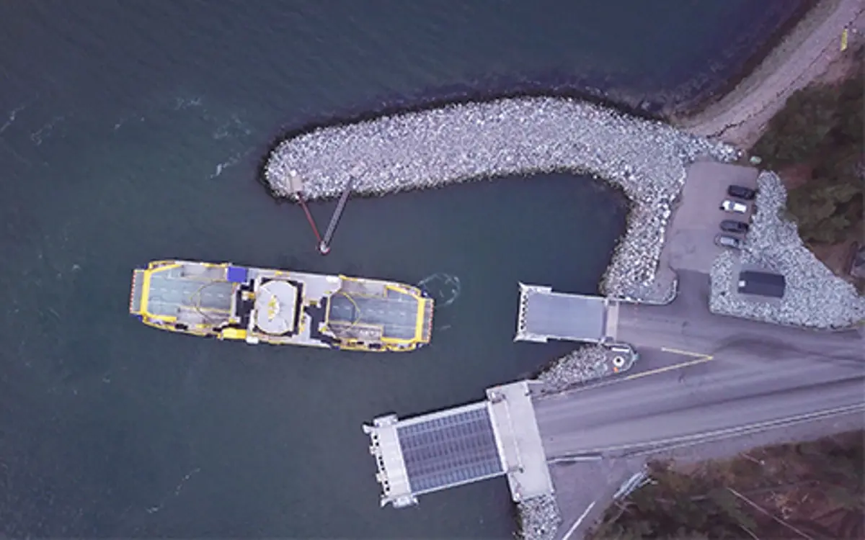
The Falco

Slide 15
The Falco
“During the demonstration, the Falco, with 80 invited VIP guests aboard, conducted the voyage under fully autonomous control. The vessel detected objects utilising sensor fusion and artificial intelligence and conducted collision avoidance. It also demonstrated automatic berthing with a recently developed autonomous navigation system. All this was achieved without any human intervention from the crew.
“The Falco is equipped with a range of advanced sensors which allows it to build a detailed picture of its surroundings, in real time and with a level of accuracy beyond that of the human eye.”
Press releases | Rolls-Royce - Rolls-Royce and Finferries demonstrate world’s first Fully Autonomous Ferry, https://www.rolls-royce.com/media/press-releases/2018/03-12-2018-rr-and-finferries-demonstrate-worlds-first-fully-autonomousferry.aspx

Slide 16
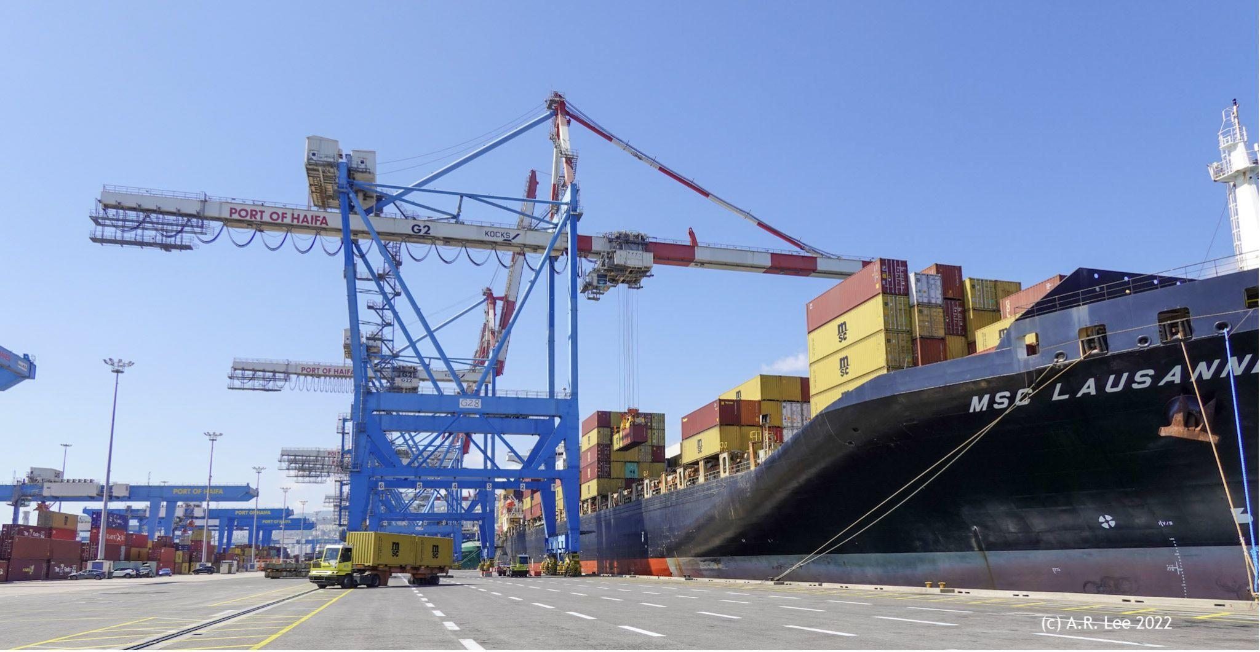
Manually operated gantry cranes - Port of Haifa, Israel

Slide 17
Automated cranes (headed to Port of Ashdod, Israel)

Slide 18
The future of the maritime industry …

Slide 19
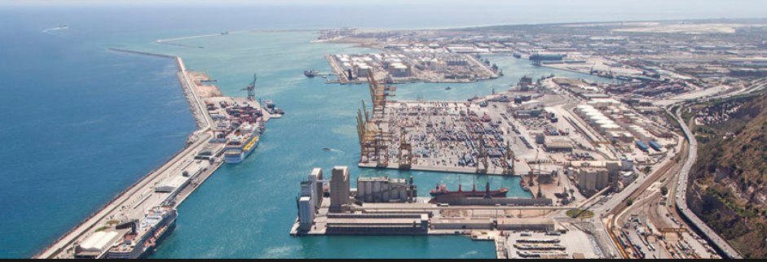
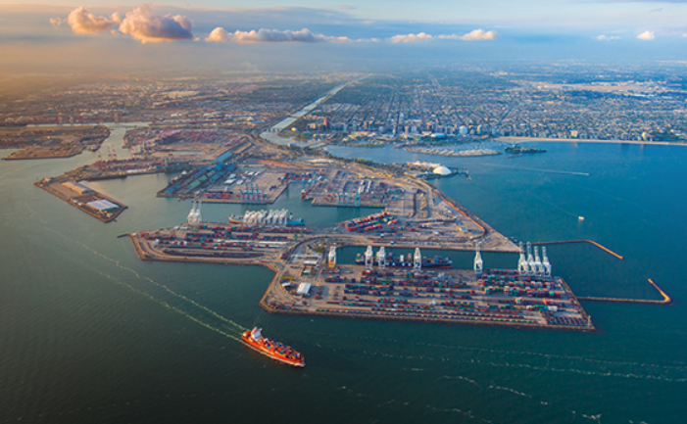
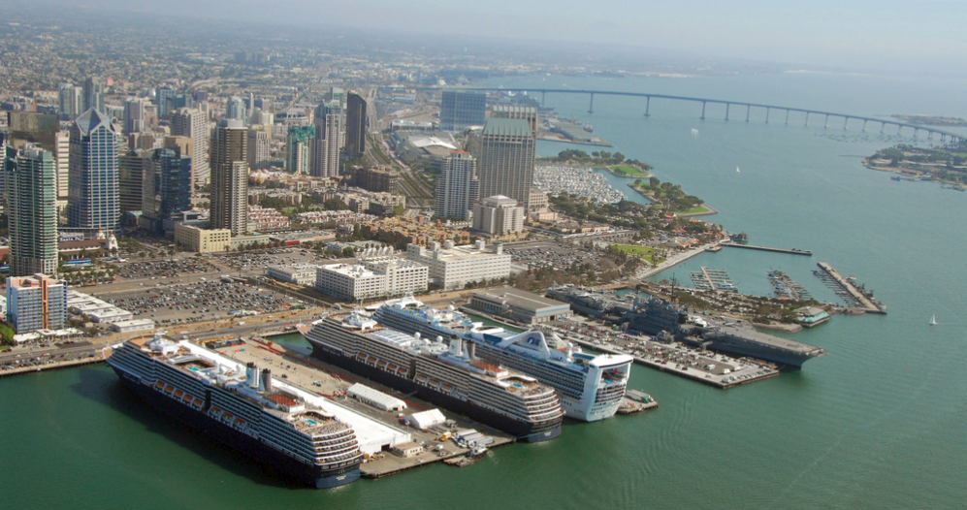
Port breaches
Notes:
LONG BEACH
BARCELONA
SAN DIEGO
3 successful breaches IN 2 MONTHS

Slide 20
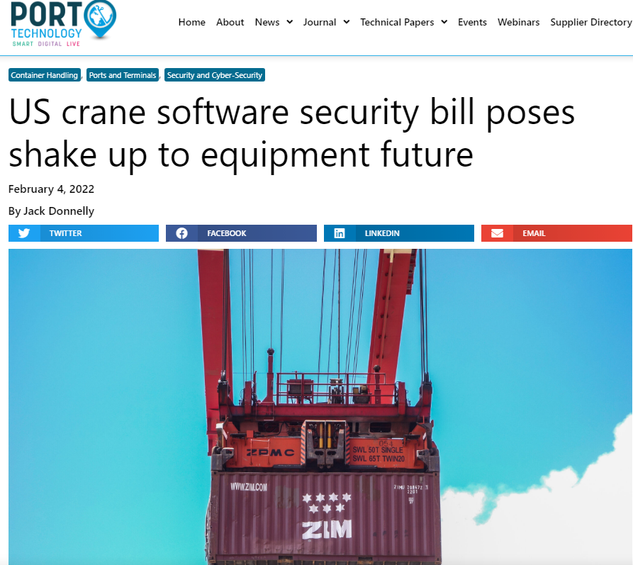
Concerns
Pending U.S. Congress legislation:
Control purchases of automated gantry cranes manufactured in China

Slide 21
Guidelines On Maritime Cyber Risk Management
These rapidly changing technologies and threats make it difficult to address these risks only through technical standards. As such, these Guidelines recommend a risk management approach to cyber risks that is resilient and evolves as a natural extension of existing safety and security management practices.
MSC-FAL.1/Circ.3 5 July 2017

Slide 22
Examining Cybersecurity and a “Risk Management Approach”
Cyber
Security
Who/what is being secured?
Territorial scope of intervention
Structures ensuring security
Intensity of protection
Married with “safety” (“protection”?)
Energy security
Safety-at-sea
Maritime safety
Transport safety
National security
Protection against
Willful acts
Illegal acts
Natural risks
National defense (military threats)
Relationship with “safety-at-sea”

Slide 23
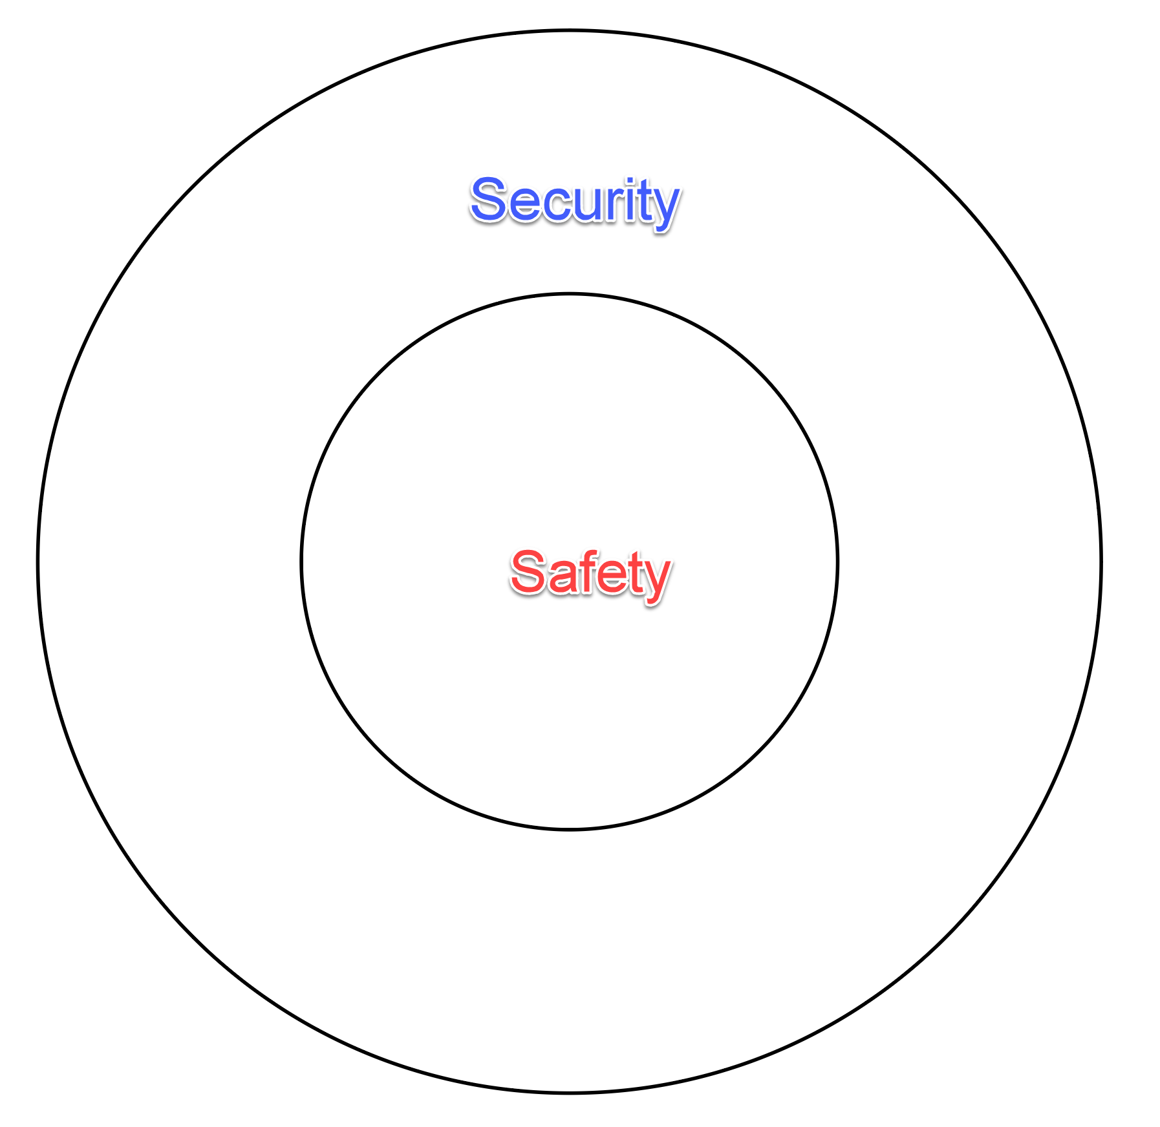

Slide 24
Concepts for the Framework
“Security Law”
Safety reinforced by Security
“Maritime cybersecurity” for ports, maritime transportation, assets
Security incident and a safety incident interconnected
ISPS Code 2002 port protection
PFSA, PFSP
“Single window systems”
Cyberspace risk attention: distinguishing IT and OT
ENISA, EUMSS, EU Directive 2016/1148
Coordination among stakeholders in maritime-port sector

Slide 25
Framework for maritime security
Safety of Life at Sea Convention (SOLAS)
International Safety Management (ISM) Code
International Code for Security of Ships and Port Facilities (ISPS)
IMO Maritime Safety Committee (MSC)

Slide 26
EU Directive 2016/1148
EU-wide cybersecurity legislation harmonizing national cybersecurity capabilities, cross-border collaboration and the supervision of critical sectors across the EU.
Recitals 10 and 11:
[10] “In the maritime and inland waterway transport sector, safety requirements for companies, ships, port facilities, ports and vessel traffic services under Union legal acts cover all operations, including radio and telecommunication systems, computer systems and networks” and
[11] “when identifying operators” of essential services “in the water transport sector, Member States should take into account existing and future international codes and guidelines developed in particular by the International Maritime Organisation, with a view to providing individual maritime operators with a coherent approach.”

Slide 27
2019 European Cybersecurity Act
Strengthened ENISA’s position vis-à-vis Member States
Defined the framework for cybersecurity certification for
ICT products
Services and processes

Slide 28
How do you legislate / regulate the human element?
The human element was responsible for 82 percent of attacks analyzed during 2021
2022 Verizon DBIR

Slide 29
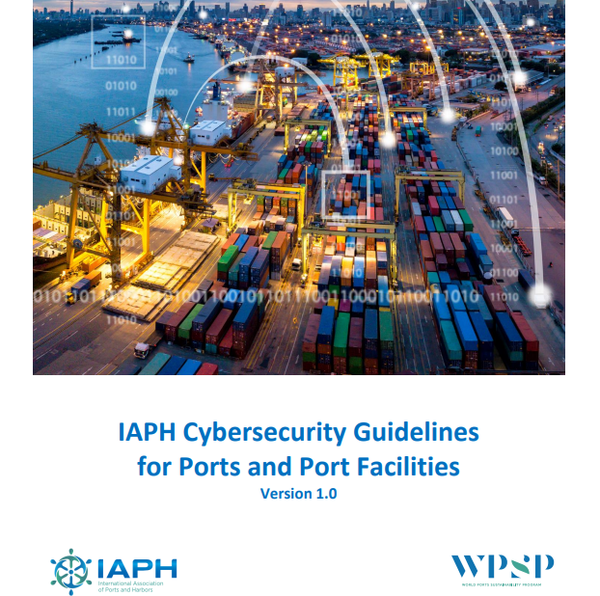
IAPH Guidelines

Slide 30
Maritime Industry: Vulnerable
The Marine Industry is Vulnerable
Insider threats
Jamming and spoofing
Mismatched, out-of-date software
Inadequate budget allocation
Limited training
General lack of readiness
Impacts
Cargo stolen or lost
Port disruptions
Physical Damage
Loss of life
Ecological Harm
Terror incident
Lost revenue
Lost stakeholder confidence

Slide 31
Maritime Industry Vulnerabilities & Challenges
Over-reliance on outdated technology
Ignorance of IT security
Tech complexity
Lack of standards
Electronic data with various levels of data protection
Created, accessed, processed, stored, transmitted
Large number of substantial financial transactions between a wide range of stakeholders
Operating with complex IT/OT environments

Slide 32
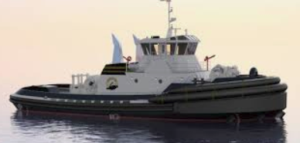
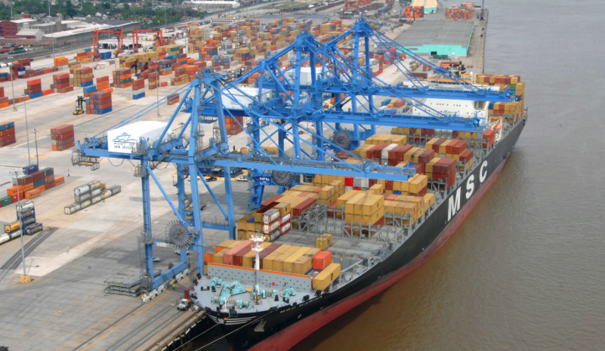
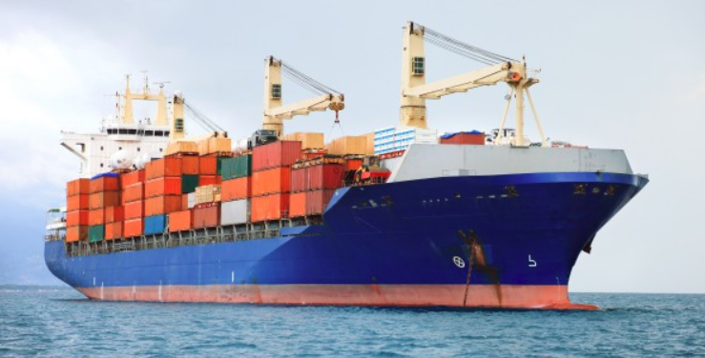
2018 Jones Walker Maritime Cybersecurity Survey
126 respondents from throughout the maritime industry
Including:
75 Vessel operators and owners
28 Port operators / service providers
23 Cargo shippers
from Small (36), mid-size (58), and large (23) companies

Slide 33
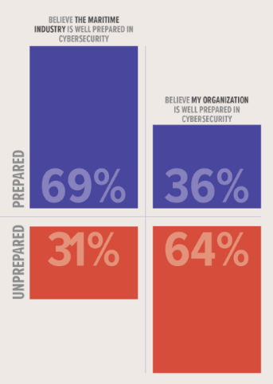
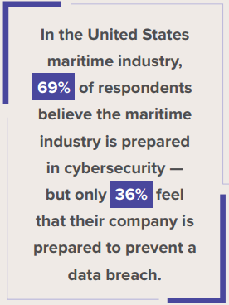
Respondents believe the industry is prepared … … but their own companies are not ready.

Slide 34
Big companies claim they’re ready. Mid- and small companies -- not so much.
100 percent of large companies
-- prepared to deal with a data breach.
Respondents from small (94%) and mid-size companies (81%) reported that their organizations were unprepared to prevent a data breach.

Slide 35
Readiness by sub-sector (not ready)

Slide 36
Readiness by sub-sector (not ready)
= 70% unprepared = 68% unprepared = 43% unprepared

Slide 37
Readiness measured by bad outcome
* Negative public opinion * Lost customers * Lost business partners
* Lost confidential * Lost intellectual property * Mandatory notification

Slide 38
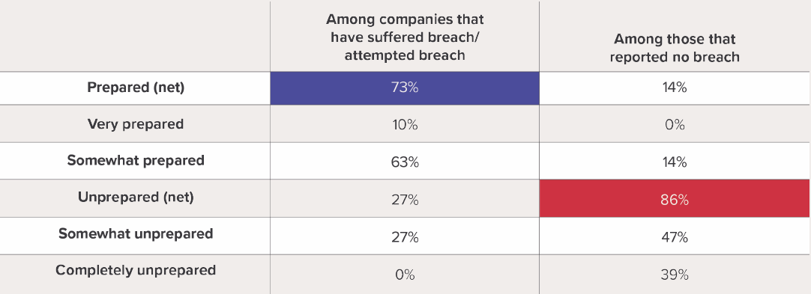
“One who has experienced shipwreck shudders even at a calm sea.” -- Ovid
Notes:
If you’ve ever been snakebit, you learn about antivenom and keep it close.

Slide 39
What do cyber-secure companies look like?
Include cybersecurity as part of their OT and strategic plans
Devote budget like their company’s reputation depends on it
Develop and maintain disaster recovery, business continuity, and other contingency plans
Document and implement cybersecurity policies and procedures
Appoint empowered information security officers, with well-defined roles and responsibilities
Train their workforce in cybersecurity procedures
Participate in threat assessments and share information
Obtain or re-evaluate cyber risk insurance

Slide 40
Annual cost of Ransomware
2015: $325 million (USD) annually
2017: $5 billion
2018: $8 billion
2019: $11.5 billion
2021: $20 billion
2024: $42 billion
2026: $71.5 billion
2028: $157 billion
2031: $265 billion
Source: Cybersecurity Ventures, June 2022

Slide 41
The optimist expects the wind to change. The realist adjusts the sails.
- William Arthur Ward

Slide 42
Questions?
Andrew R. Lee, CIPP/US
Partner
Jones Walker LLP
504.582.8664
alee@joneswalker.com

